Slide 1
CS 4530: Fundamentals of Software Engineering
Module 12: Software Engineering & Security
Adeel Bhutta, Joydeep Mitra and Mitch Wand
Khoury College of Computer Sciences
© 2025, released under CC BY-SA

Slide 2
Learning Objectives for this Module
By the end of this module, you should be able to:
Define key terms relating to software/system security
Explain why it is important to consider non-functional requirements like security during design
Explain 5 common vulnerabilities in web applications and similar software systems, and describe some common mitigations for each of them.
Explain the STRIDE Framework for Security by Design

Slide 3
Security: Basic Vocabulary (1)
Security is a set of non-functional requirements (sometimes called “CIA”):
Confidentiality: is information disclosed to unauthorized individuals?
Integrity: is code or data tampered with?
Availability: is the system accessible and usable?
Notes:
Security is often considered a broad non-functional requirement: systems are expected to be “secure”. But as we’ll see in this lecture, security covers a range of different security requirements. Here are three common security requirements.
Confidentiality - is information disclosed to unauthorized parties?
Integrity - is our code or data tampered with, at rest, or in transit
Availability - Can someone prevent my system from otherwise functioning? note that leaving something unplugged solves confidentiality and integrity :)
Discussion: Think about recent examples of security events and how they violated these properties

Slide 4
Security: Basic Vocabulary (2)
Asset: something of value that is the subject of a security requirement
Threat: a potential event that could compromise a security requirement
Vulnerability: a characteristic or flaw in system design or implementation, or in the security procedures, that, if exploited, could result in a threat

Slide 5
Security: Basic Vocabulary (3)
Exploit: a technique or method for exploiting a vulnerability
Attack: realization of a threat
Mitigation: a technique for making an attack less likely, more expensive, or less valuable to an attacker.
Security architecture: a set of mechanisms and policies that we build into our system to mitigate risks from threats

Slide 6

Security isn't always free
In software, as in the real world…
You just moved to a new house, someone just moved out of it. What do you do to protect your belongings/property?
What are the assets that need protection?
residents, furniture, cash, your stuff
What are the vulnerabilities?
doors, windows
Notes:
Before getting into software security, let’s talk a bit about physical security. Imagine that you have just moved to a new house, and someone just moved out. Are there things that you would want to do to secure your belongings? For instance - do you change the locks? Maybe you are concerned that the former tenant still has keys.
(Walk through example, then ultimately point out that you live in a house with lots of glass)

Slide 7
Security is about managing risk
We need to make our software secure too!
Increasing security might:
Increase development & maintenance cost
Increase infrastructure requirements
Degrade performance
But, if we are attacked, increasing security might also:
Decrease financial and intangible losses
Notes:
We saw in the example of the new home that there may be some security measures that seem needlessly expensive (hiring a security guard) or expensive AND counter to some of our other requirements (replacing glass windows with blast doors increases security at the expense of aesthetics).
Let’s think about this in the case of an IT system.
Here are some examples of the kinds of tradeoffs that we might consider when thinking about these threats.(read slide)
Ultimately, the last question of “how likely we are to be attacked in some way” is going to be very subjective, and we will need to consider the financial cost of a successful attack – attacks with very large payoffs (for the attacker) might motivate attackers to try harder.

Slide 8
Secure by Design is mantra of modern software development
Traditional Software Process Models do not bake security into the software development lifecycle
Security issues are usually an after-thought
The modern approach to secure software engineering is to consider security during the design phase
How?
By starting with threat modeling
Notes:
<read slide>
Your developers will be more conscious of security issues if they discuss them on a regular basis during their ordinary workflow.

Slide 9
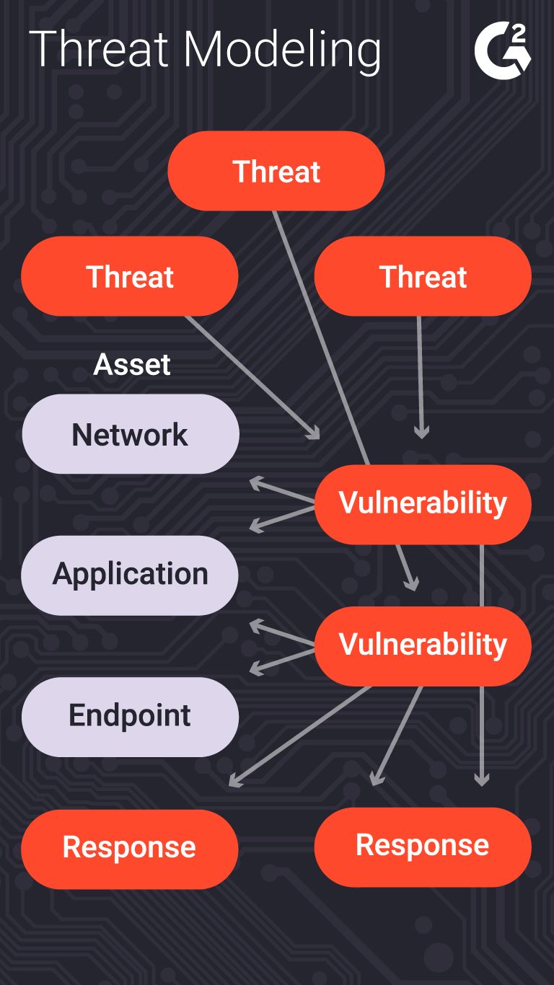
Threat modeling can help us analyze the issues
What is being defended? Who do we trust? What parts of the system do we trust?
What malicious actors exist and what attacks might they employ? (Identification)
What is the likelihood and impact of each threat? (Assessment)
What can we do in case of attack? (Countermeasures)
How do we adapt to evolving risks? How do we update threat models regularly? (Review)
Notes:
The process of considering the potential risks, and ”non risks”, or trusted actors/components, is called “threat modeling”.
This is typically a structured process in which an organization analyzes questions like:
(read slide)
Of course, creating a threat model is not a one-time event. The model will need to be continually revised during the development process as the system is refined, and after deployment as the environment changes.
Of course there’s a whole ecosystem of consultants to help with this process.

Slide 10
Two views of Security
Let’s look at Security from High Level first (call it Project-Level Security)
Then we will look at Security from the App level.
Notes:
We saw in the example of the new home that there may be some security measures that seem needlessly expensive (hiring a security guard) or expensive AND counter to some of our other requirements (replacing glass windows with blast doors increases security at the expense of aesthetics).
Let’s think about this in the case of an IT system.
Here are some examples of the kinds of tradeoffs that we might consider when thinking about these threats.(read slide)
Ultimately, the last question of “how likely we are to be attacked in some way” is going to be very subjective, and we will need to consider the financial cost of a successful attack – attacks with very large payoffs (for the attacker) might motivate attackers to try harder.

Slide 11
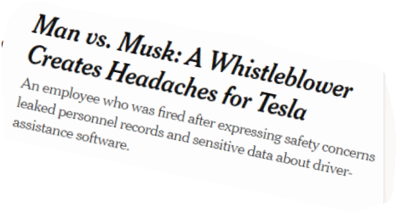
A Baseline Security Policy {at Project Level}
Trust:
Developers writing our code (at least for the code they touch)
Server running our code
Popular dependencies that we use and regularly update
Don’t trust:
Code running in browser
Inputs from users
Other employees (employees should have access only to the resources they need)
Notes:
For some of these questions, there are baseline answers that are widely applicable.
Re last bullet: Remember that insider attacks are common!

Slide 12
A Baseline Security Policy {at Project Level}
Encrypt all data in transit, sensitive data at rest
Use multi-factor authentication
Use encapsulated zones/layers of security
Different people have access to different resources
Principle of Least Privilege
Log everything! (employee data accesses/modifications) (maybe)
Do regular, automatic, off-site backups
Bring in security experts early for riskier situations
Notes:
Before, we said that a security architecture is a set of mechanisms and policies that we build into our system to mitigate risks from threats.
Luckily, there are best practices that are applicable in most situations. The extent to which we implement these practices will depend on the other factors in our threat model.
Consider two-factor authentication. We all have to deal with it; it’s always painful to have a 2FA pop up to delay us in accomplishing some task.
What processes in our system do we want to protect with 2FA? User or developer login? (Almost certainly yes). What else? Can you imagine having to do a 2FA on every commit?

Slide 13
5 major classes of vulnerabilities
Vulnerability 1: Code that runs in an untrusted environment
Vulnerability 2: Untrusted Inputs
Vulnerability 3: Bad authentication (of both sender and receiver!)
Vulnerability 4: Malicious software from the software supply chain
Vulnerability 5: Failure to apply security policy.
https://owasp.org/www-project-top-ten/
Notes:
Here are 5 general classes of vulnerabilities. For each vulnerability, we will look at possible exploits and possible mitigations.
An unfortunate recurring theme that we will see in these defenses is that there is no silver bullet. An extremely motivated attacker (say, a nation-state like the US, China, or Russia) can likely, with enough time and resources, break into anything. But, we will see what we can do to increase the cost of that attack.

Slide 14

Vulnerability 1 Example: authentication code in a web application
function checkPassword(inputPassword: string){
if(inputPassword === 'letmein'){
return true;
}
return false;
}
Front End
Curses! Foiled Again!
User controls this
Trust boundary
Back End
Fix: Move code to back end (duh!)
We control this
Notes:
What if we put some sensitive code in the front end of our web app? In general, there’s nothing to prevent the user from looking at the code or modifying it. Here, the correct password is sitting in plaintext where the user can find it.
That’s an extreme example, of course, but there are others: the user might be able to extract keys and other secrets from the front-end code.
The general fix to this is to move that sensitive code into our backend, which we should, hopefully, trust to faithfully execute the code.
Another example: if we have external services (like a database, or some other API, like one for accessing cloud resources), we might be tempted to distribute our database password (or key for third party API) with the application, so that it can directly connect to our database.
Our frontend might try to restrict what data the user can access, but because the user can also use these credentials to directly connect to our database, they will have the power to do whatever is permitted for those credentials.
(Professor Wand says: yes, this animation is cheesy, but I had way too much fun doing it).

Slide 15
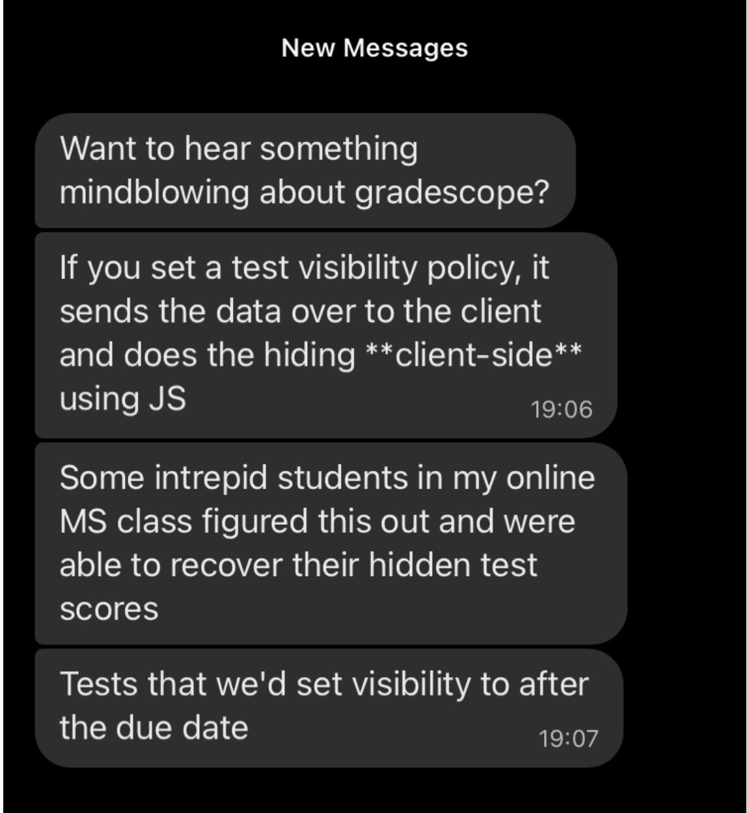
Who would do such a silly thing?
Notes:
<click>
Answer: Gradescope!

Slide 16
Vulnerability 2: Data controlled by a user flowing into our trusted codebase
https://xkcd.com/327/
Notes:
The next class of threat that we will consider is: untrusted user inputs. Imagine that we have solved our problem of “do we trust where the code runs” by running that code on our own server that we control. Surely, we still receive inputs from users, who we should not trust.
Here is a pop-culture reference from XKCD that makes fun of this class of threat

Slide 17
Example: code injection
String query = "SELECT * FROM accounts WHERE name='" + request.getParameter(“name") + "'";
Parameter name | Constructed Query | Effect
Alice | SELECT * FROM accounts WHERE name=‘Alice’; | Select a single account
Alice O’Neal | SELECT * FROM accounts WHERE name=‘Alice O’Neal’; | SQL Error
5’ OR ‘1’=‘1 | SELECT * FROM accounts WHERE name=‘5’ OR ‘1’=‘1’; | Select all accounts
OOPs!
OWASP A03:2021-Injection
Notes:
Here’s a real example. By putting in a suitably crafted query into an innocuous-looking query, a user could select ALL accounts in the database. This is number 3 in the OWASP list of most common vulnerabilities (the link is on the slide, and also in the resources links for this lecture). OWASP stands for the Oen Web Application Security Project.

Slide 18
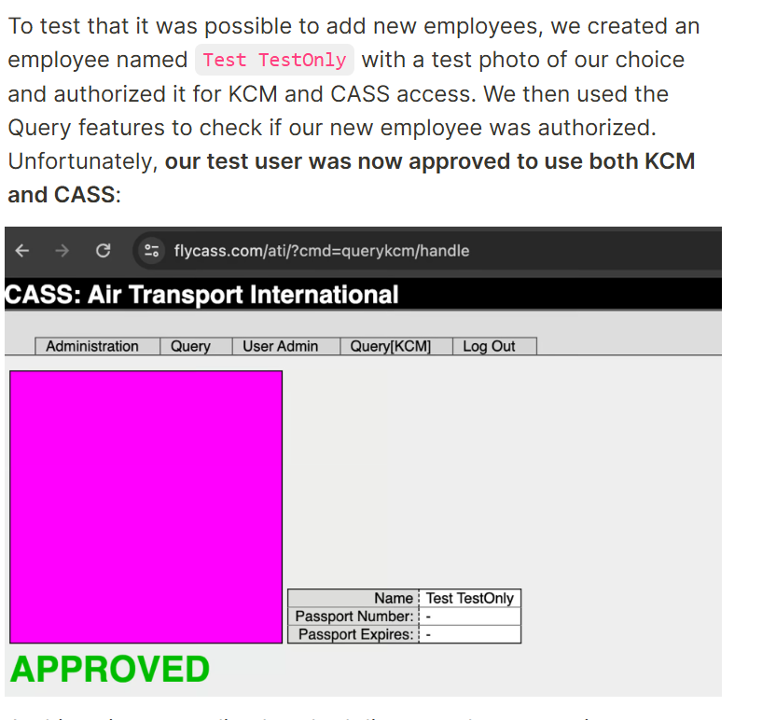
Bypassing airport security via SQL injection (2024!)
"Known Crewmembers" can get to the cockpit without inspection.
Large airlines: Each airline runs its own authorization system, but small airlines rely on a vendor
The authors found one such vendor that had an SQL injection error
Using the username of ' or '1'='1 and password of ') OR MD5('1')=MD5('1, we were able to login to FlyCASS as an administrator of Air Transport International!
OOPs!
https://ian.sh/tsa
Notes:
Followup: After the authors identified the problem, they attempted to report it. On the website they wrote:
We ended up finding several more serious issues but began the disclosure process immediately after finding the first issue.
We had difficulty identifying the right disclosure contact for this issue. We did not want to contact FlyCASS first as it appeared to be operated only by one person and we did not want to alarm them. On April 23rd, we were able to disclose the issue to the Department of Homeland Security, who acknowledged the issue and confirmed that they “are taking this very seriously”. FlyCASS was subsequently disabled in KCM/CASS and later appears to have remediated the issues.
After the issue was fixed, we attempted to coordinate the safe disclosure of this issue. Unfortunately, instead of working with us, the Department of Homeland Security stopped responding to us, and the TSA press office issued dangerously incorrect statements about the vulnerability, denying what we had discovered.

Slide 19
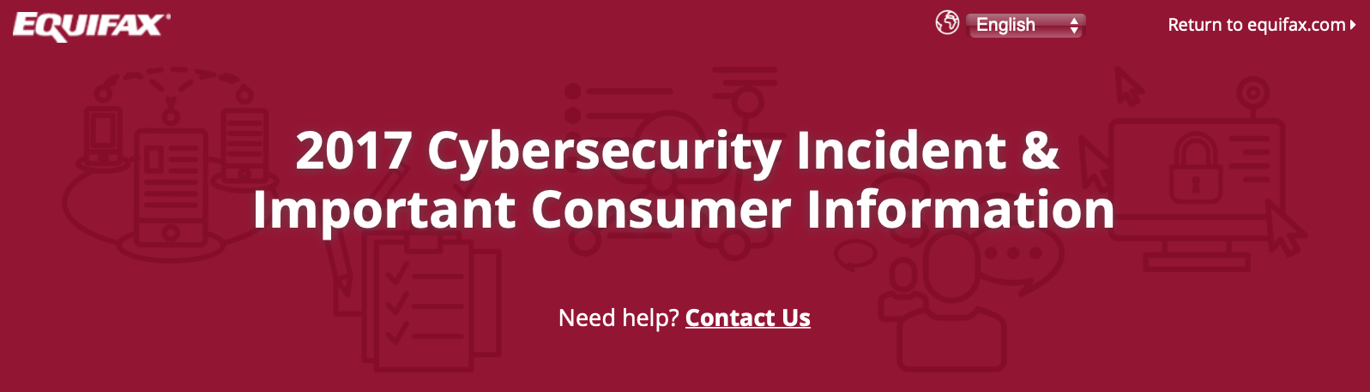
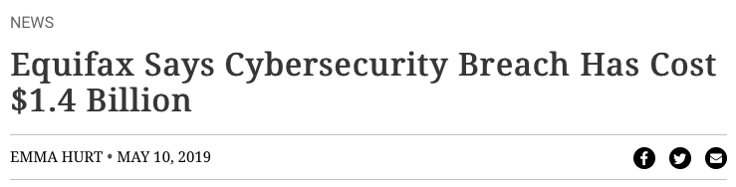
A code injection attack (in Apache struts) cost Equifax $1.4 Billion
CVE-2017-5638 Detail
Current Description
The Jakarta Multipart parser in Apache Struts 2 2.3.x before 2.3.32 and 2.5.x before 2.5.10.1 has incorrect exception handling and error-message generation during file-upload attempts, which allows remote attackers to execute arbitrary commands via a crafted Content-Type, Content-Disposition, or Content-Length HTTP header, as exploited in the wild in March 2017 with a Content-Type header containing a #cmd= string.
Notes:
For example: the Equifax data breach in 2017 that has thus-far cost the firm over 1.4 billion dollars was caused by a vulnerability in their web app, which allowed untrusted user input to flow into a part of the application that would then execute that input as java code.

Slide 20
Project-level mitigations for code injection attacks
Use tools like TSOA or swagger-codegen to automatically generate safe code.
Manually sanitize inputs to prevent them from being executable
Avoid unsafe query languages (e.g. SQL, LDAP, language-specific languages like OGNL in java). Use “safe” subsets instead.
Avoid use of languages (like C or C++) that allow code to construct arbitrary pointers or write beyond a valid array index
eval() in JS – executes a string as JS code
Notes:
Special characters like <, >, ‘, “ and ` are often involved in exploits involving untrusted inputs. So filter them, and use tools to make sure that every data flow involving user input is filtered.
Query languages might have “safe” apis and “unsafe” APIs, where the “Safe” APIs automatically perform some sanitization, allowing you to add place-holders for arguments to a query that YOU define, where the user-controlled input can ONLY flow into a specific part of the query (preventing the attacker from constructing their own query)
Don’t use “unsafe” languages like C or C++. In these languages you can write beyond a valid array index. Such buffer overflows are the primary way in which an attacker can execute arbitrary code on your app. (There are whole conferences devoted to ways of preventing this.)
And of course don’t use ‘eval’ in JS. Use a lint filter to check for this.

Slide 21

Vulnerability 3: Bad Authentication
HTTP Request
Server
HTTP Response
client page
(“Avery”)
Server
(“Amazon”)
How does Amazon know that this request is coming from Avery?
How does Avery know that this response is coming from Amazon?
Notes:
"Identification and Authentication Failures" is #7 on the 2021 OWASP Top 10 Web Application Security Risks. (See the page for this module on the course web site for URL).
i

Slide 22
How does Amazon, Inc. know that this request is coming from Avery?
Password
Establishes that the request is coming from someone who knows Avery’s password
2-factor authentication is a way of linking Avery's password to the real Avery.
Something the real Avery has (physical key, bank card, device token)
Something the real Avery knows (name of first pet, etc.)
Something the real Avery is (biometrics, address history, etc.)

Slide 23
How does Avery know that this request is coming from Amazon, Inc.?
The answer depends on public-key cryptography (PKI)
also called "asymmetric cryptography"
"Cryptographic Failures" is #1 on the 2021 OWASP list of Top 10 Web Application Security Risks
PKI uses two keys: Public and Private
Encrypted with: | Who can encrypt? | Who can decrypt?
Private Key | Only the owner of the private key | Anyone with the public key, i.e. everyone
Public Key | Anyone | Only the owner of the corresponding private key
Notes:
Public-key cryptography can be used to solve these problems and many, many more

Slide 24
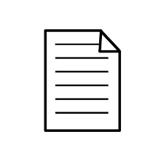
A message encrypted with a public key can only be decrypted with the matching private key
Avery wants to send a confidential message to Blair, so they encrypt it with Blair's public key
Plain text Message
Public Key
Encrypted Message
Private Key
Plain text Message
Blair
Blair
Blair
Confidentiality achieved!
Only Blair has the key to decrypt the message!
Notes:
So, to reiterate, with public key cryptography, anybody can prepare a private message that can only be decrypted by the holder of a private key. To do so, they encrypt the message using the recipient's *public* key. <click>
After encrypting the message with the public key, the only party that can decrypt is is the holder of the corresponding private key. <click>
This effectively addresses the “confidentiality” requirement

Slide 25
Encrypt messages with the sender's private key to ensure integrity
Avery wants to send a message, and they want whoever reads to be confident that it was Avery who sent the message.
Plain text Message
Private Key
Encrypted Message
Public Key
Plain text Message
Avery
Avery
Avery
Only Avery had the key this was locked with!
Integrity achieved!
Notes:
Conversely, a sender can encrypt their message with their own private key. The receiver observes that they can unlock it with public key of the person who claims to have sent it. Therefore, they know who sent it, and furthermore that it was not altered in transit. <click through slide>.

Slide 26
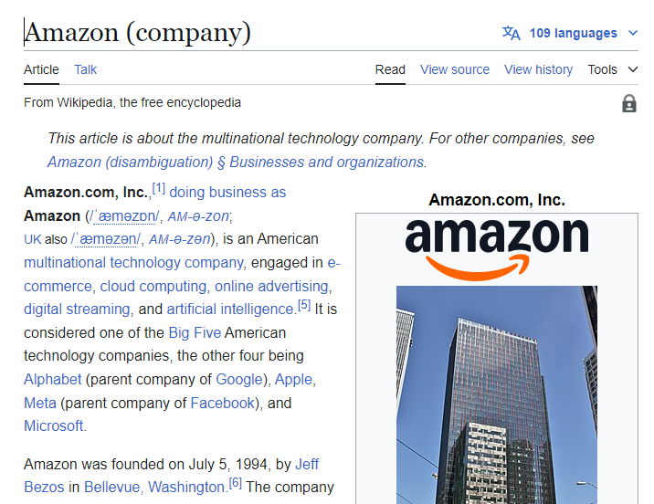
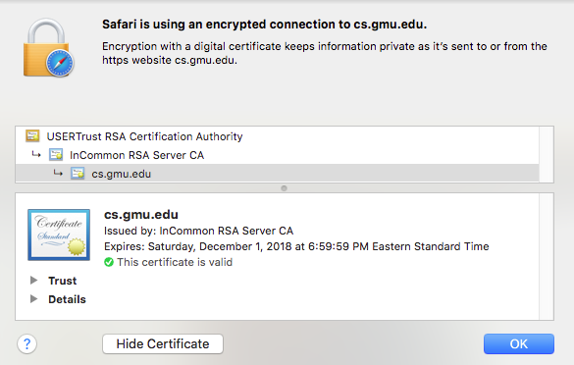
How does Avery get public key from Amazon, Inc.?
Avery can rely on a third party, called a "certificate authority" (CA).
The CA can endorse that a public key is held by a certain real-world entity.
The third party issues a certificate containing the Amazon's public key, encrypted with the CA's own private key.
When our browser visits amazon.com, amazon.com sends its certificate to our browser.
Avery decrypts the certificate, using the CA's public key. Avery now has the real public key of "Amazon Inc".
Every computer/browser is shipped with these root CA public keys
To acquire a certificate, Amazon, Inc. must have shared their public key and some real-world proof that they are amazon.com to the CA.

Slide 27
Certificate Authorities issue SSL Certificates
Amazon
Certificate Authority
CA private key
CA private key
amazon.com private key
amazon.com certificate
(AZ’s public key + CA’s sig)
CA public key
My Laptop
amazon.com public key
amazon.com public key
Some real-world proof that we are really amazon.com
CA public key
amazon.com certificate
(AZ’s public key + CA’s sig)
Notes:
Certificate authorities create SSL certificates using asymmetric (aka public/private key) cryptography.
Here is a a brief overview of the trust relationships when an SSL certificate is granted, and when it is checked by a browser.
The process starts out as follows:
Amazon.com has some public key and private key
Certificate authority has some public key and private key
Everyone who trusts the CA has the CA’s public key. This is distributed with OS’s. That is, we must trust the CA.
(build until proof of amazon.com appears on right) To acquire a certificate, Amazon.com will share their public key and some real-world proof that they are amazon.com to the CA
(build until certificate appears and moves back to left) the CA will use their private key to sign amazon’s public key, noting that they are endorsing this public key as being held by amazon.com
(build once) then, when we visit amazon.com, the server will present its certificate, which our browser can validate by checking that it is signed by the CA’s private key (which we do using the public key)

Slide 28
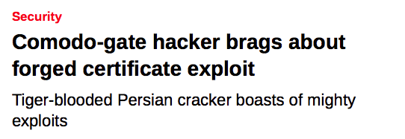
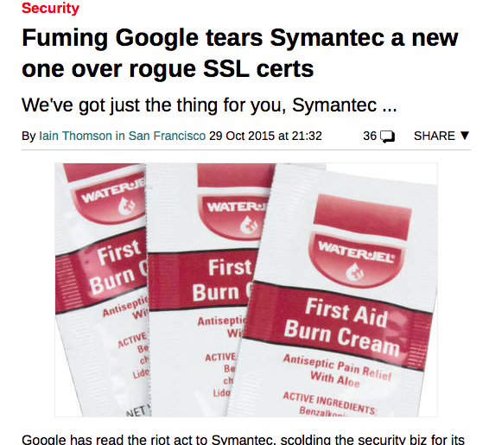
What happens if a CA is compromised, and issues invalid certificates?
OOPs!
Notes:
Oops…
As we saw, placing code in a trusted environment and using SSL to protect communication between trusted components is a great approach to mitigate threats to our execution environment (although it’s not perfect).

Slide 29
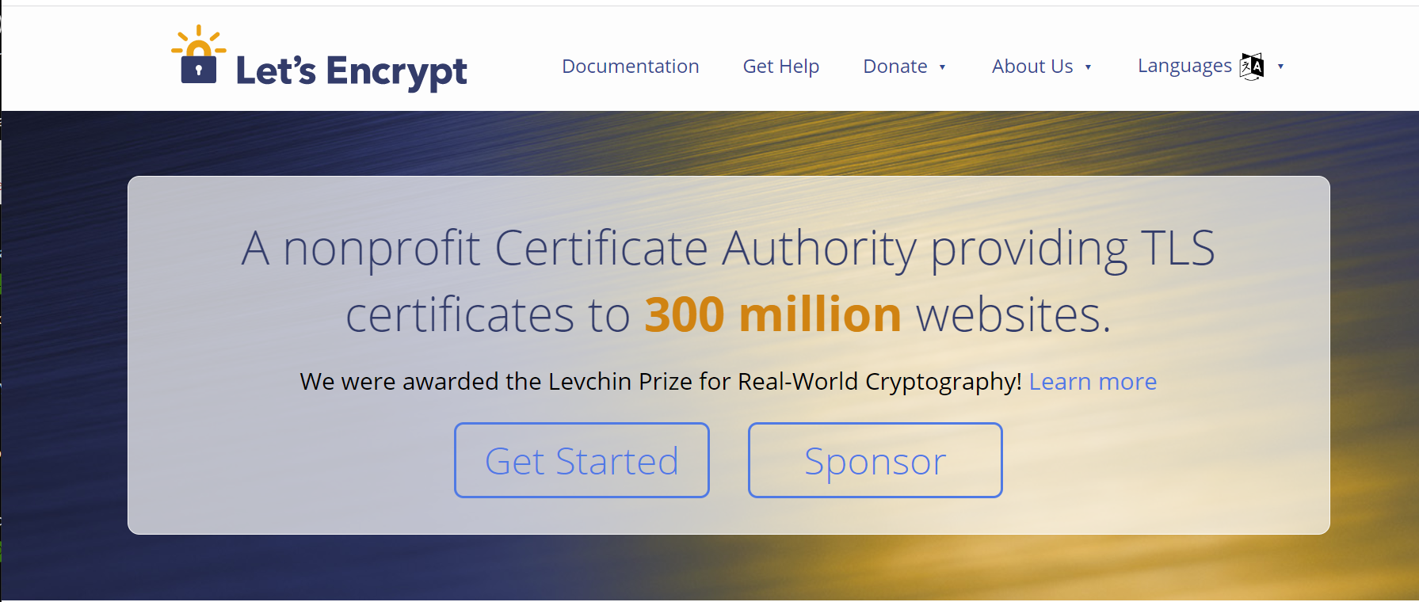
You can do this for your website for free
letsencrypt.com

Slide 30
Project-level mitigations for access-control threats
Implement multi-factor authentication
Make sure passwords are not weak, have not been compromised.
Apply per-record access control
Principle of least privilege
Harden pathways for account creation, password reset.
Use an SSO to handle login
They might do it better than you can.
Notes:
Prof. Wand says: Password reset is particularly nasty. I had a friend (let’s call him Dave) whose ccs email password was hijacked by a bad guy. Since many, if not all, of Dave’s other accounts were linked to his ccs email, the bad guy could reset Dave’s passwords on all his other accounts. This happened on a weekend, and I had to telephone somebody in the Systems group to lock Dave’s email account *immediately* to minimize further damage.
The moral of the story is that your email password is particularly valuable, because a bad guy can use it to reset passwords on all your other accounts.

Slide 31
Vulnerability 4: Supply-Chain Attacks
Do we trust our own code?
Third-party code provides an attack vector
Notes:
Next, let’s consider so-called software supply chain threats.

Slide 32
The software supply chain has many points of weakness
External dependencies
Build process
Distribution process (including updates)
Operating environment
In-house code
Notes:
The “software supply chain” includes many potential points of weakness. We might need to consider threats at each phase of the software development and deployment process, including:
External dependencies: potential for malicious dependencies
In-house code: potential for insider attack (a developer who is either malicious, or whose laptop has been otherwise compromised through another vulnerability)
Build process: potential for build system to be compromised through another vulnerability or insider attack
Distribution process: potential for a malicious update to be pushed out to your customers
Operating environment: potential for other threats in the operating environment to result in a compromise of our software

Slide 33
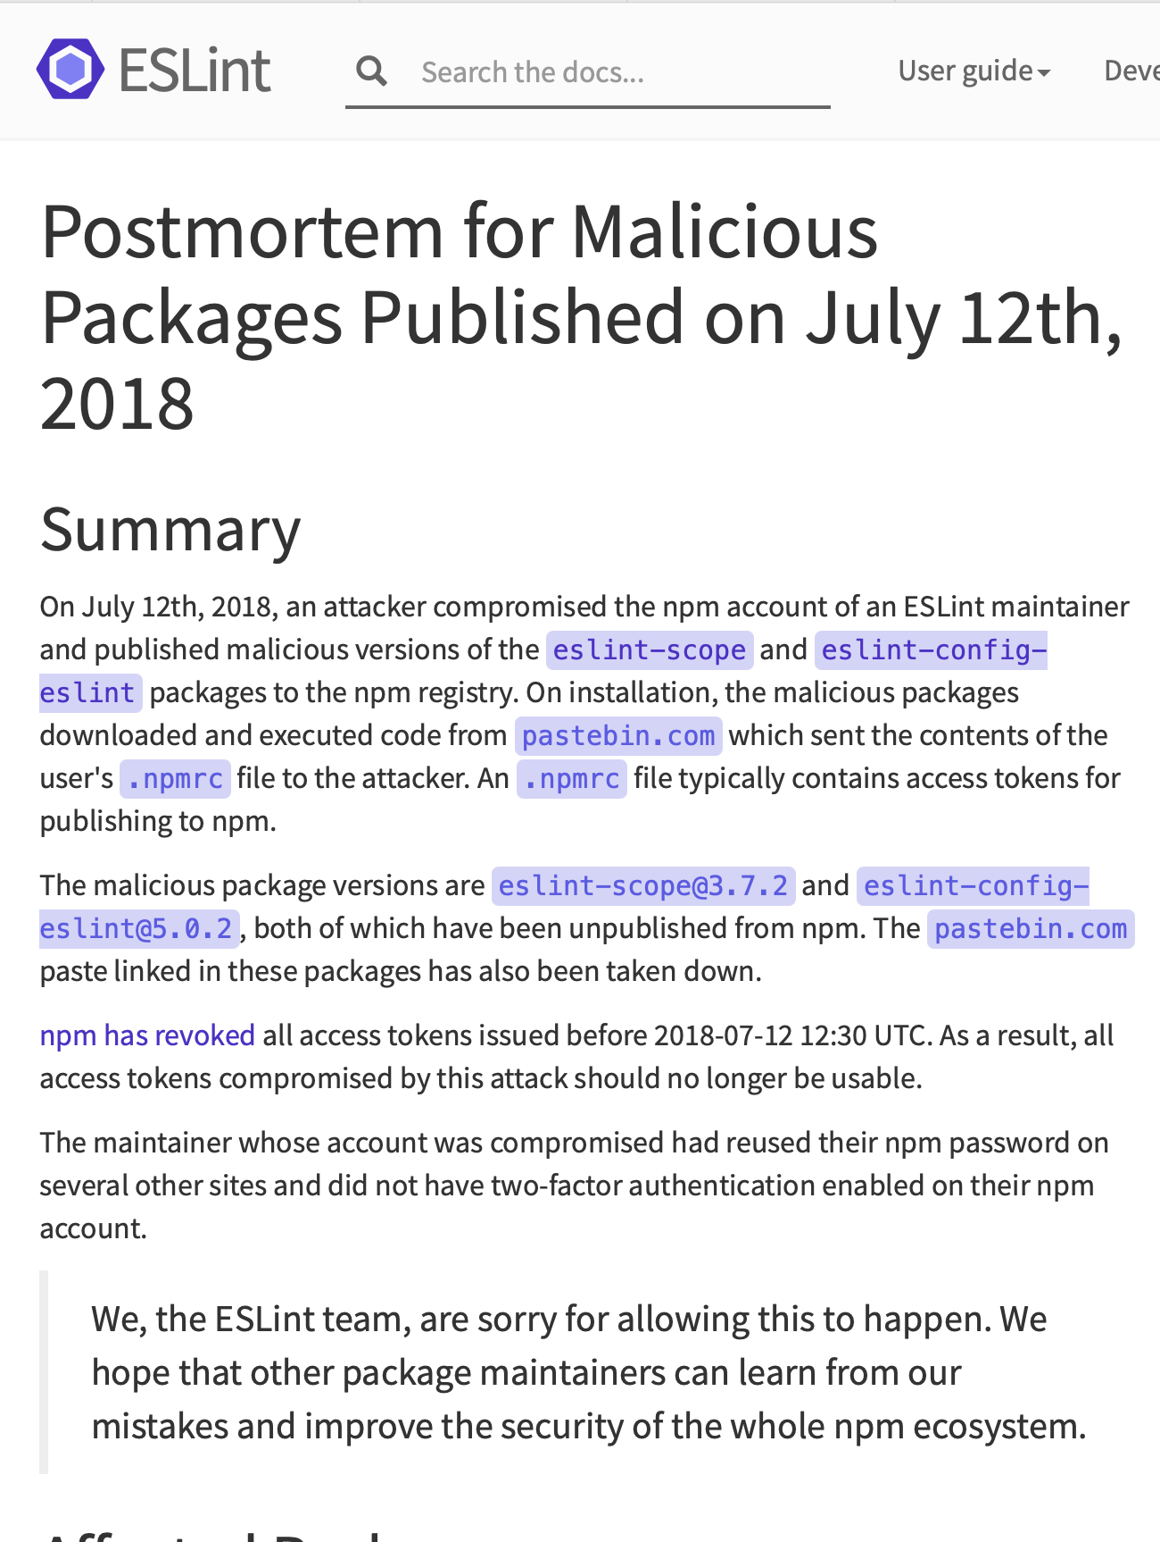
Example: the eslint-scope attack (2018)
On 7/12/2018, a malicious version of eslint-scope was published to npm.
eslint-scope is a core element of eslint, so many many users were affected.
Let’s analyze this…
https://eslint.org/blog/2018/07/postmortem-for-malicious-package-publishes/
Notes:
Let’s look at a couple of examples. In 2018, a malicious version of an eslint package called eslint-scope was published. This was a quite serious issue.
https://eslint.org/blog/2018/07/postmortem-for-malicious-package-publishes/

Slide 34
This incident leveraged several small security failures
An eslint-scope developer used their same password on another site.
The other site did not use 2FA
Password was leaked from the other site.
Attacker created malicious version of eslint-scope
Many users did not use package-lock.json, so their packages automatically installed the new (evil) version.
The malicious version sent copies of the user’s .npmrc to the attacker. This file typically contains user tokens.
Estimated 4500 tokens were leaked and needed to be revoked.
Notes:
Let’s look at the sequence of events, as explained in the post-mortem report on the preceding slide.
<Read Slide>
Discuss: how many violations of good security practices do you see here?
The developer used the same password on two different sites
The other site did not use 2FA
The other site did something else that allowed the password to leak.
Users did not protect their packages against silent version updates.

Slide 35
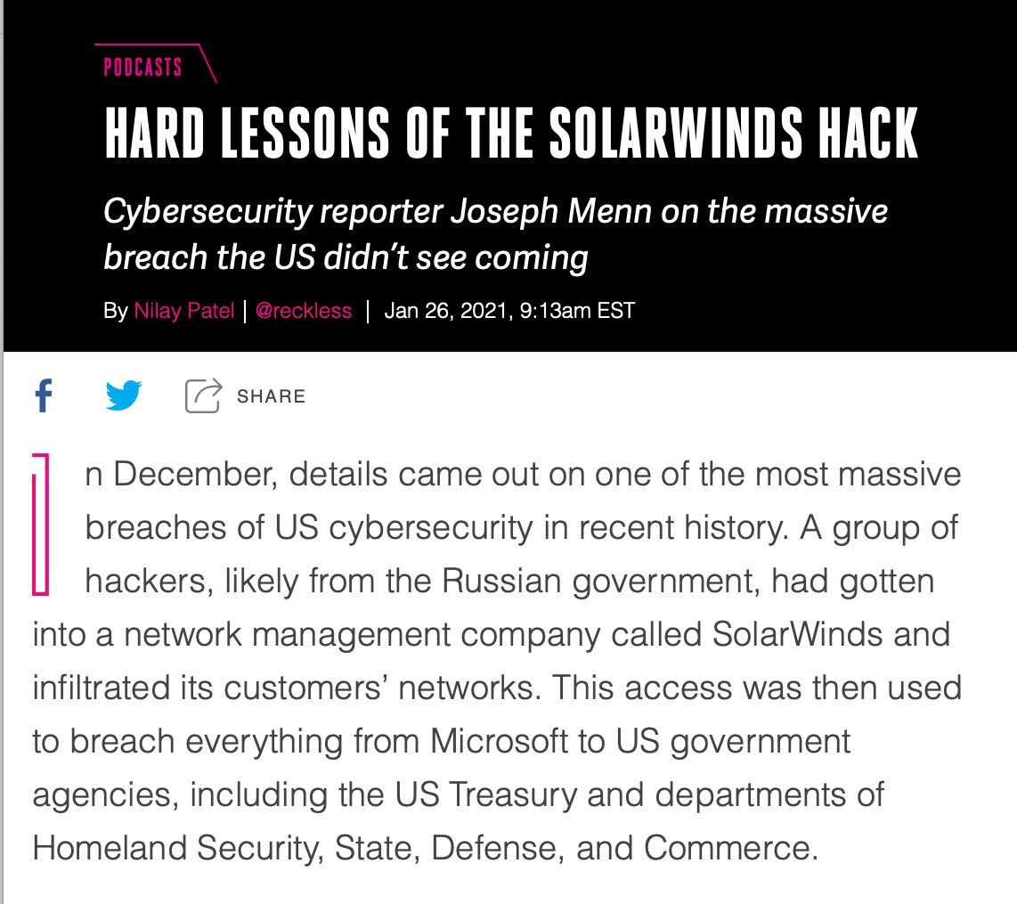
Example: the SolarWinds attack (2020)
Many networks compromised
Not discovered for months

Slide 36
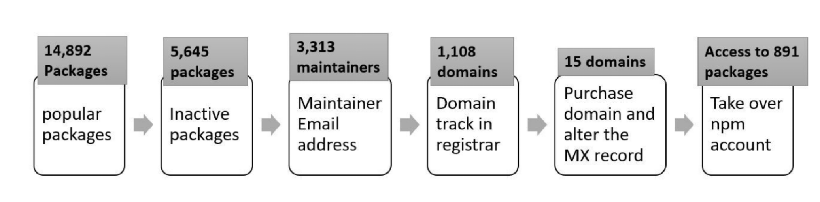
A 2021 NCSU/Microsoft found that many of the top 1% of npm packages had vulnerabilities
Package inactive or deprecated, yet still in use
No active maintainers
At least one maintainer with an inactive (purchasable) email domain
Too many maintainers or contributors to make effective maintenance or code control
Maintainers are maintaining too many packages
Many statistics/combinations: see the paper for details.
“What are Weak Links in the npm Supply Chain?” By: Nusrat Zahan, Thomas Zimmermann, Patrice Godefroid, Brendan Murphy, Chandra Maddila, Laurie Williams https://arxiv.org/abs/2112.10165
Notes:
Here is a list of significant vulnerabilities found in the most popular packages (“top 1%”).

Slide 37
Your suppliers' risks are your risks
"Known Crewmembers" can get to the cockpit without inspection.
Large airlines: Each airline runs its own authorization system, but small airlines rely on a vendor
The authors found one such vendor that had an SQL injection error
Using the username of ' or '1'='1 and password of ') OR MD5('1')=MD5('1, we were able to login to FlyCASS as an administrator of Air Transport International!
OOPs!
https://ian.sh/tsa
Notes:
The problem with supply-chain vulnerabilities is that they are recursive! Your suppliers' risks easily become your risks.

Slide 38
Project-level Threat Mitigations
External dependencies
Audit all dependencies and their updates before applying them
In-house code
Require developers to sign code before committing, require 2FA for signing keys, rotate signing keys regularly
Build process
Audit build software, use trusted compilers and build chains
Distribution process
Sign all packages, protect signing keys
Operating environment
Isolate applications in containers or VMs
Notes:
While we could easily solve problems in our own code by bolting on some useful additional components (like using SSL), it’s not so easy to solve threats to our software supply chain process – there need to be process-based solutions for these process-based problems.
These kinds of threats are currently some of the most-talked about (and most feared) because they are complex to defend against.
For example: how do we audit dependencies? Who does that, and when? What is “secure enough” for a dependency?
Who loves needing to do 2FA for every time you sign into canvas? How much worse is it if you had to do it for each git commit?
Signatures are useful only insofar as we trust the signer. If a developer’s computer is compromised (say, through a phishing attack), what good is that signature? Same for distribution.
Perhaps the best news-you-can-use here is to isolate each application in its own container or VM, reducing the scope of security breaches to be isolated within that environment and not directly impacting other applications.

Slide 39
Vulnerability #5: A security architecture must include a security culture
Getting security right is about people as well as software
Question: How do you get your developers to do all this?
Answer: Security architecture is a set of mechanisms and policies that we build into our system to mitigate risks from threats
Notes:
It’s not just software, it’s not just company policy– we need to make sure our development teams have a culture that includes security.

Slide 40
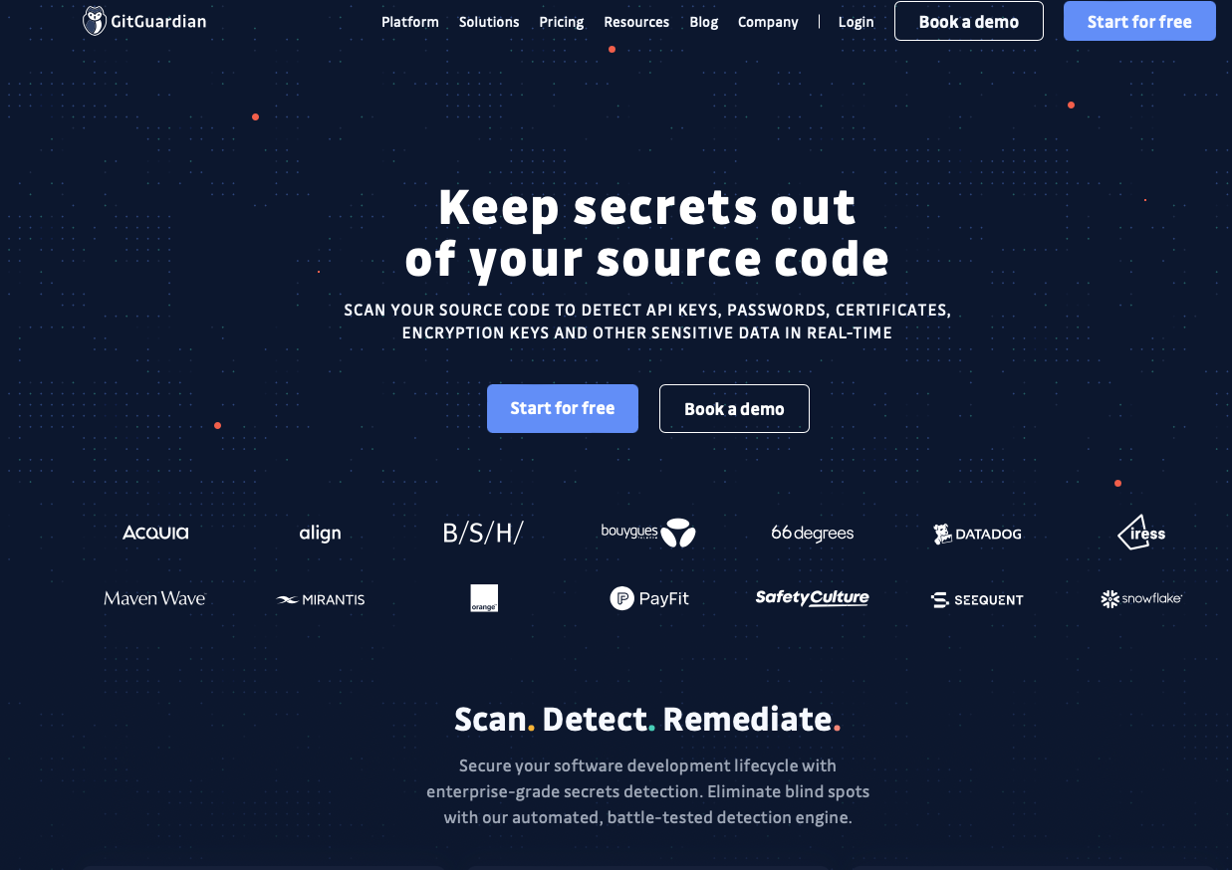
Example mechanism: secret detection
Recall: SSL only talks about public/private keys.
Applications may have many other secret values (e.g. access tokens for other services)
Tools like GitGuardian automatically detect secrets in repositories

Slide 41
Mechanisms aren’t enough: Do developers keep secret keys secret?
Industrial study of secret detection tool in a large software services company with over 1,000 developers, operating for over 10 years
What do developers do when they get warnings of secrets in repository?
49% remove the secrets; 51% bypass the warning
Why do developers bypass warnings?
44% report false positives, 6% are already exposed secrets, remaining are “development-related” reasons, e.g. “not a production credential” or “no significant security value”
Is it a management problem or a tool problem?
“Why secret detection tools are not enough: It’s not just about false positives - An industrial case study”
Md Rayhanur Rahman, Nasif Imtiaz, Margaret-Anne Storey & Laurie Williams https://link.springer.com/article/10.1007/s10664-021-10109-y
Notes:
Simply using a secret detection tool isn’t enough. This is an interesting study.
(Read slide for key findings)
Discussion:
Bypassing warnings for false positives (e.g. not an actual credential) are reasonable (although perhaps annoying); the remaining reasons that are “development related” such as: * It is not a production credential (for example, it is a credential for a non-shipping prototype)
The credential doesn’t protect any data, service, etc., with significant security value
Rely on judgement calls of the developer that do not reflect overall security model. Many successful attacks rely on chaining multiple vulnerabilities together, getting a foothold in one system to then be able to access another. These kinds of judgement calls should not be made at the level of individual developers who may not see the whole security landscape.
Other reasons why secrets not promptly removed:
* Removing the credential now would break services. etc., that belong to other teams
* We were not sure what secret management/other solution we can use to resolve the problem.
These are process-related issues, and require

Slide 42
Elements of a security culture
Make security a regular part of the process
Include security tools as part of the build/release process
Tools may have false positives and false negatives
Educate developers about when how to recognize positives that look false, but aren’t
Include security review as regular part of code review
Notes:
<read slide>
Your developers will be more conscious of security issues if they discuss them on a regular basis during their ordinary workflow.

Slide 43
Wow! That’s a lot of High-level stuff
Let’s pause a minute …..
Notes:
We saw in the example of the new home that there may be some security measures that seem needlessly expensive (hiring a security guard) or expensive AND counter to some of our other requirements (replacing glass windows with blast doors increases security at the expense of aesthetics).
Let’s think about this in the case of an IT system.
Here are some examples of the kinds of tradeoffs that we might consider when thinking about these threats.(read slide)
Ultimately, the last question of “how likely we are to be attacked in some way” is going to be very subjective, and we will need to consider the financial cost of a successful attack – attacks with very large payoffs (for the attacker) might motivate attackers to try harder.

Slide 44
Two Views of Security
Let’s call it Security from High Level first (call it Project-Level Security)
Now, let’s look at Security from the App level.
Notes:
We saw in the example of the new home that there may be some security measures that seem needlessly expensive (hiring a security guard) or expensive AND counter to some of our other requirements (replacing glass windows with blast doors increases security at the expense of aesthetics).
Let’s think about this in the case of an IT system.
Here are some examples of the kinds of tradeoffs that we might consider when thinking about these threats.(read slide)
Ultimately, the last question of “how likely we are to be attacked in some way” is going to be very subjective, and we will need to consider the financial cost of a successful attack – attacks with very large payoffs (for the attacker) might motivate attackers to try harder.

Slide 45
A Baseline Threat Model {at App Level}
Concentrate on technical risks rather than broad threats.
Are there any missing controls?
Is there a data flow that can be abused?
Many technical threats combine to create broad threats.
Focusing on vague nation-state attacks and zero-day exploits can overshadow essential application security details.
Notes:
<read Slide>

Slide 46
A Baseline Security Policy {at App Level}
Collaborate with stakeholders to understand security needs
Frequent and small iterations
Start with the thinnest slice of the system. e.g.,
User registration flow
A microservice and it’s collaborating services
Current iteration
Repeat and refine them.
Defining a threat model upfront for the entire system is counter productive.
Notes:
<Read Slide>

Slide 47
Basic Structure of Threat Modeling in Agile
An effective threat modeling session must deal with the three primary questions
Activity | Question | Outcome
Explain and explore | What are you building? | A technical diagram
Brainstorm threats | What can go wrong? | A list of technical threats
Prioritize and fix | What are you going to do? | Add prioritized fixes to backlog (todo list)
Notes:
<Read Slide>

Slide 48
STRIDE Framework can help identify Common Threats
The STRIDE framework is useful to reason about potential threats.
Spoofing
Tampering
Repudiation
Information Disclosure
Denial of Service
Elevation of Privilege
You will learn more about this in the activity posted on the module page!
Notes:
<read slide>

Slide 49
Let’s Walk through an Example
Imagine working on this user story
“As a customer, I need a page where I can see my customer details so I can confirm they are correct”
Let’s work through our questions:
What are you building?
What can go wrong?
What are you going to do?
Notes:
<read slide>

Slide 50
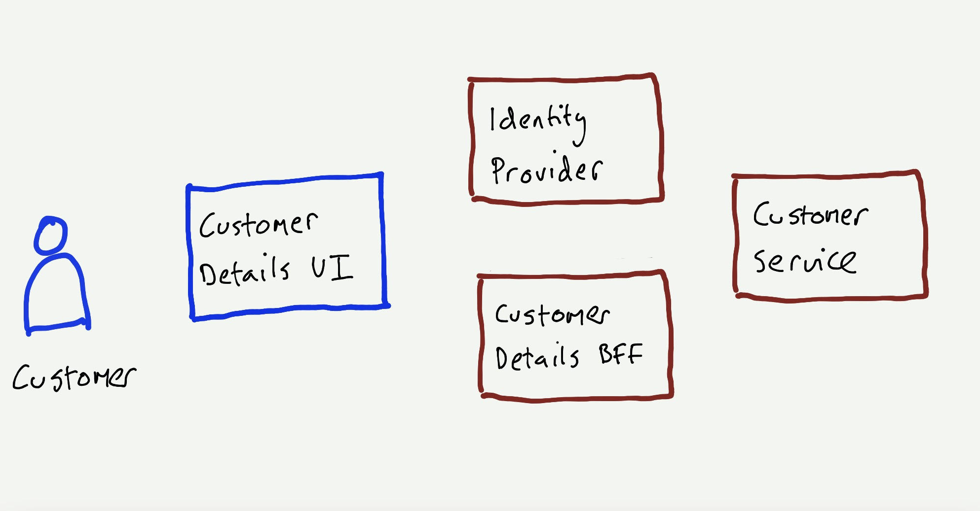
What are we building?
Use a sketch to represent
relevant components
users that interact with a component
collaborative components
Notes:
<read slide> BFF is Backend for Frontend

Slide 51
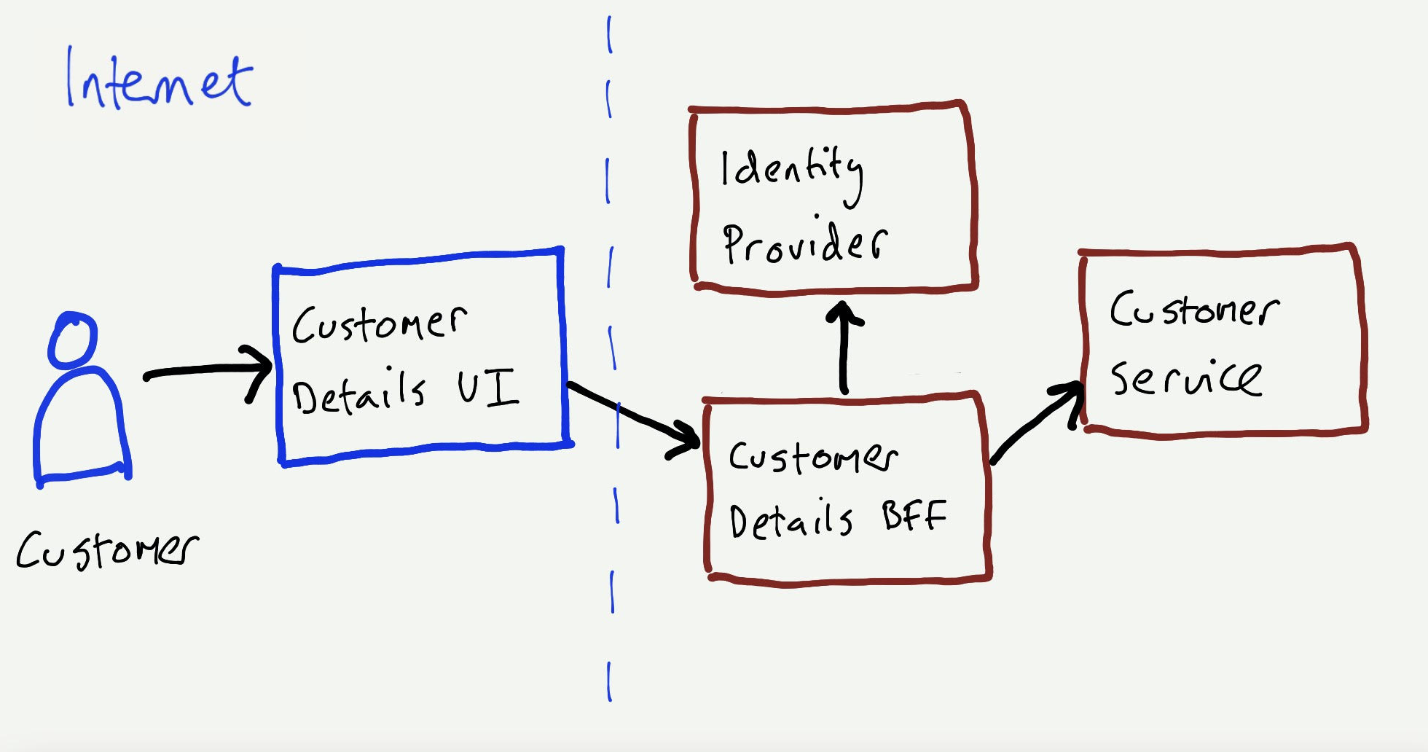
What are we building?
Explicitly model data flows in the sketch.
Data flows help show where requests originate (source).
Label networks and show boundaries between them.
Notes:
<read slide>

Slide 52
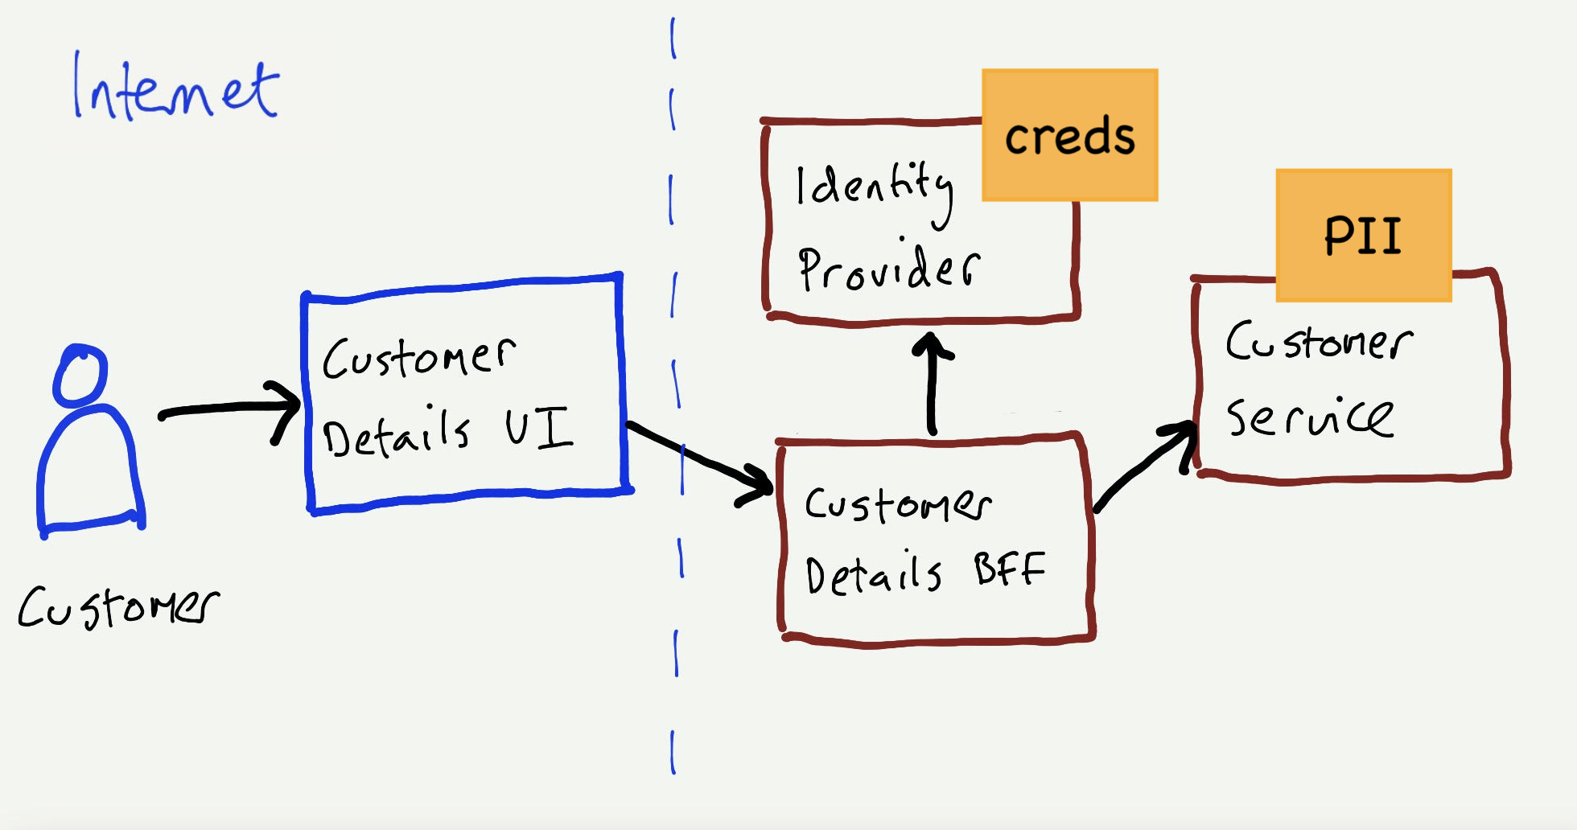
What are we building?
Identify and show assets e.g., personally identifiable information (PII), your application has access to.
Notes:
<read slide>

Slide 53
What can go wrong?
Using the STRIDE model, we should identify possible threats that can happen on each flow.
Customer -> UI
Customer -> Identity Service
UI -> BFF
BFF -> Customer Service
Notes:
<read slide>

Slide 54
What can go wrong?
Using the STRIDE model, we should identify possible threats that can happen on each flow.
Customer -> UI
Customer -> Identity Service
UI -> BFF
BFF -> Customer Service
Spoofing due to No 2-factor authentication
Spoofing due to XSS attack
Spoofing due to Absent/weak identity token validation
Tampering due to injection attacks
Spoofing due to Misconfigured TLS configuration
Privilege of escalation due to incorrect access control logic
DOS due to absence of rate limiting
Spoofing due to Absent/weak authentication (server-to-server)
Repudiation due to not logging of caller identity
Notes:
<read slide>

Slide 55
What are you going to do?
Add Highest Priority threats to backlog (as user stories or conditions of satisfaction)
Given the user is logged in When they request to view their profile page And they have a valid token
Then their profile page is displayed
Given the user is logged in
When they request to view their profile page
But they do not have a valid token
Then they are asked to login or signup
Notes:
<read slide>

Slide 56
What are you going to do?
Prioritize and Fix
Aim to address manageable number of threats (e.g., 3)
Examples of Work Breakdown:
Prevent authorization bypass when accessing an API by creating session tokens for the server
Prevent XSS attack via user input by sanitizing all inputs
Prevent Denial of service for server from the internet by using a rate limit
Repeat and refine!
A Guide to Threat Modeling by Jim Gumbley: https://martinfowler.com/articles/agile-threat-modelling.html
Notes:
<read slide>

Slide 57
Learning Objectives for this Module
You should now be able to:
Define key terms relating to software/system security
Explain why it is important to consider non-functional requirements like security during design
Explain 5 common vulnerabilities in web applications and similar software systems, and describe some common mitigations for each of them.
Explain the STRIDE Framework for Security by Design

